Slide 1

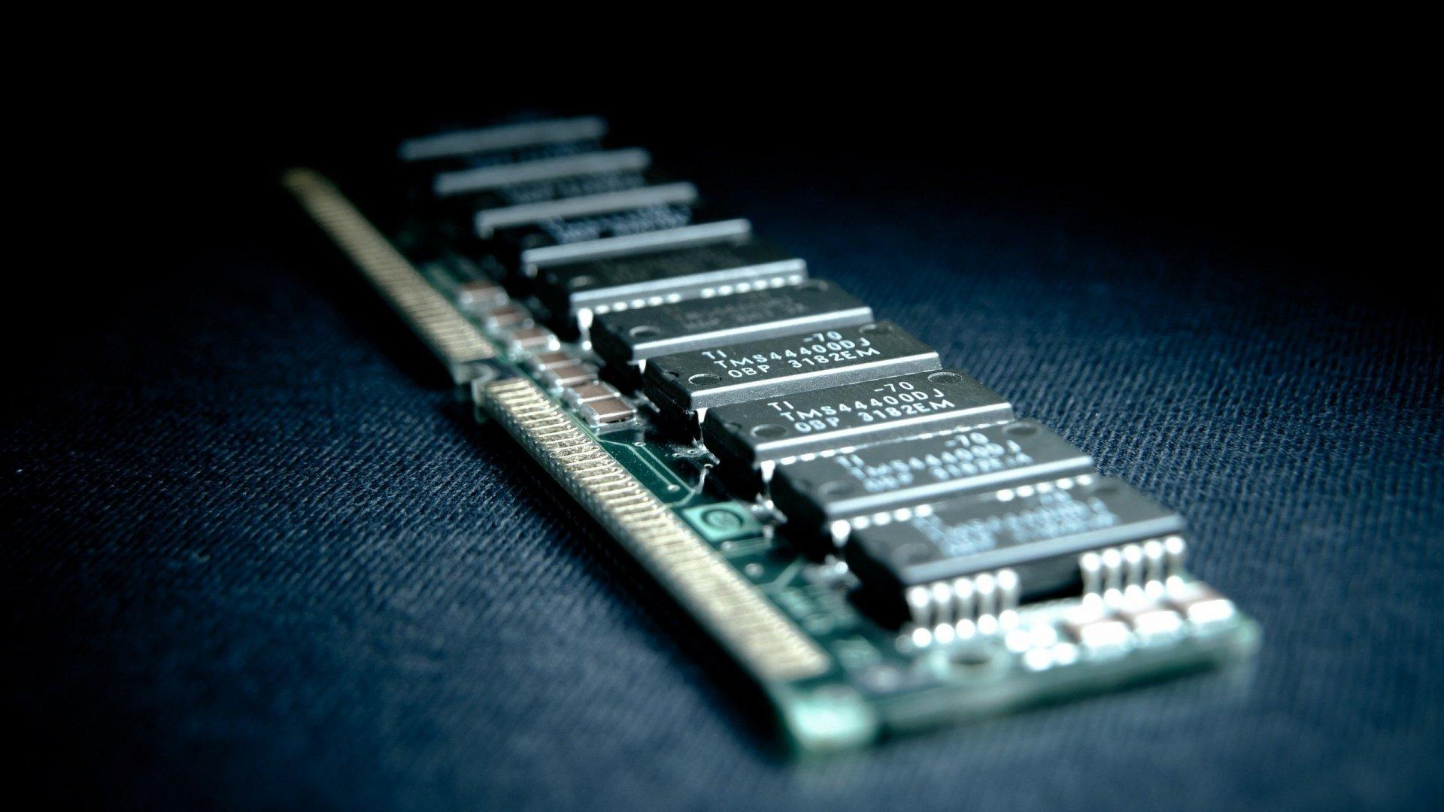
Memory Management
Team Members:
Arqam Qazi
Furquan Saiyed

Slide 2
Topics
SR.NO | TOPICS
1 | Virtual Memory
2 | Paging
3 | Segmentation
4 | Fragmentation
5 | Page Fault
6 | Page Replacement Algorithms: FIFO LRU

Slide 3
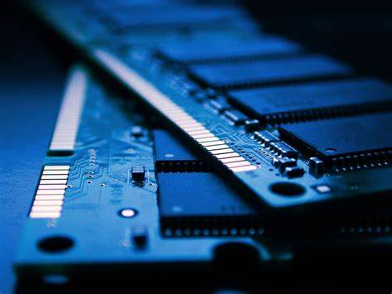
Memory Management in Operating System
Memory management allows the OS to allocate memory to processes efficiently.
It handles both the allocation and deallocation of memory space as needed.
maximizing system performance, ensuring safe process execution, and optimizing resource use.

Slide 4
Virtual Memory
Virtual memory allows the execution of processes that may not fit entirely into physical memory.
It creates the illusion of a large contiguous memory by using both RAM and disk space.
Enables large programs to run without requiring equivalent physical memory.
Isolates processes from one another, ensuring security and stability.

Slide 5
Paging
Paging divides the process's virtual memory into fixed-size blocks called pages.
The physical memory is divided into frames of the same size as pages.
When a program needs a page, it is loaded from secondary storage (disk) to memory.

Slide 6
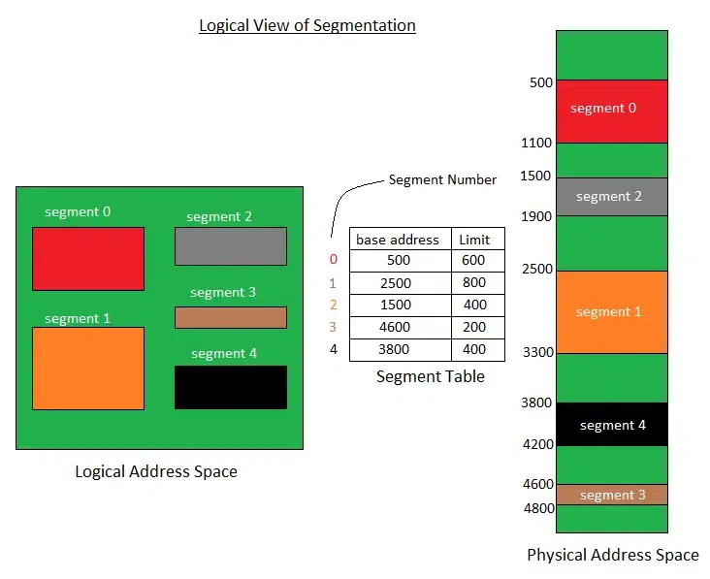
Segmentation
Segmentation divides memory based on logical divisions, like functions, arrays, or objects, rather than fixed sizes.
Each segment represents a specific part of the program or data.
These segments can grow or shrink independently, which makes segmentation more flexible compared to simple contiguous memory allocation techniques like paging.

Slide 7
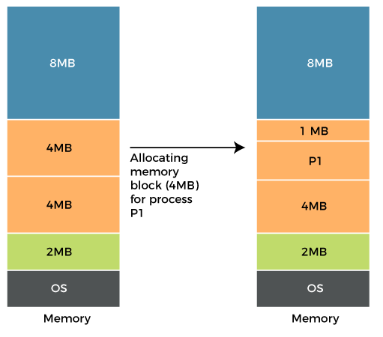
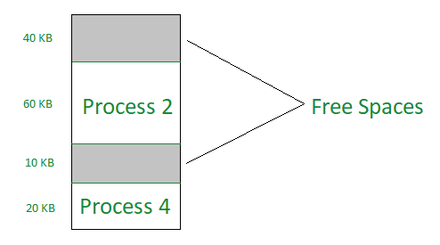
Fragmentation
Internal Fragmentation: Occurs when fixed-size memory blocks (like pages) leave unused space within allocated blocks.
External Fragmentation: Occurs when there is enough total free memory but not in contiguous blocks.

Slide 8

Page Fault
A page fault happens when a process requests a page that is not in memory.
when a program tries to access a chunk of memory that does not exist in physical memory (main memory) causes a page fault.

Slide 9
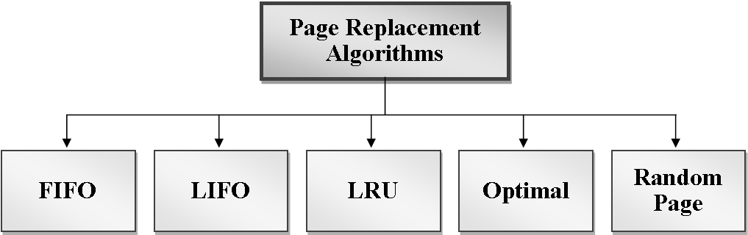
Page Replacement Algorithms
When a page fault occurs and memory is full, a page replacement algorithm decides which page to remove.
Page replacement algorithms are used to determine which page to swap out, aiming to minimize page faults and optimize performance.

Slide 10
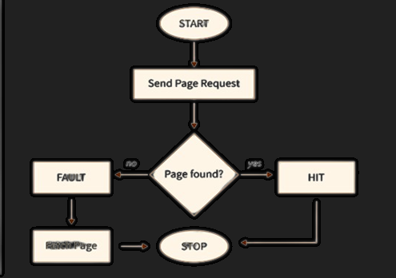
FIFO (First-In-First-Out):
Replaces the oldest page in memory, the one that was loaded the longest time ago.
Whenever a page fault occurs, the operating system looks at the front end of the queue to know the page to be replaced by the newly requested page.
Pros: Simple to implement.
Cons: Poor performance
Fetch Page

Slide 11
Use Cases of FIFO
FIFO is used in simple embedded systems or devices with predictable workloads and limited hardware complexity (e.g., printers, some small IoT devices like router switches).

Slide 12
LRU (Least Recently Used)
Replaces the page that has not been used for the longest time
Pros: Better performance than FIFO in most real-world scenarios
Cons: Requires tracking the access history of pages, which adds overhead in terms of time and space.

Slide 13
Use Cases of LRU
LRU is commonly used in operating systems for general-purpose computers (e.g., Windows, Linux) and web browsers for caching frequently accessed content.
Used in Mobile Operating Systems.

Slide 14
Conclusion
We learned about virtual memory, paging, segmentation page fault and page replacement algorithms like FIFO and LRU.

Slide 15


